Slide 1
Mutations

Slide 2
Mutations
Most uses of GraphQL are around queries
GraphQL can also be used to change data
This is called Mutation

Slide 3
Mutation Syntax
There are three main parts in the mutation request:
Mutation Object Type
Mutation Parameters
Returned Data

Slide 4

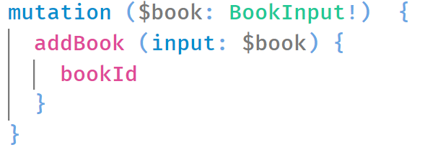
Mutation Syntax
There are three main parts in the mutation request:
mutation
object type
Arguments The objects that we want to create / modify
Can be more than one
Defines that we’re running a mutation and not a query
Returned data
Reflects the new object that was added
Mutations often receive a special input named Input Type

Slide 5
Input Type
When using queries, we usually use scalar argument:
BookId => Int
BookName => String
Etc.
With mutations we usually want to pass complex argument, containing properties of the entity we want to create

Slide 6
Input Type
This type of argument is called Input Type
Can be used in mutations, but also in queries
Needs to be defined in code and then be used in the mutation
Every complex type can be used as input type

